Slide 1
Order Forecasting
HackFest 2022
--Hrushikesh H D

Slide 2
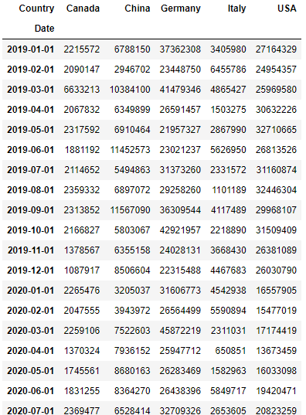
Project Objective
To explore and understand patterns in changes over time where these patterns signify the components of Time Series.
And to forecast the next 15 months’ order values for 5 countries.
Dataset Overview
The dataset contains total order data for 5 countries
from Jan 2019 to April 2022 provided by a manufacturing company.

Slide 3
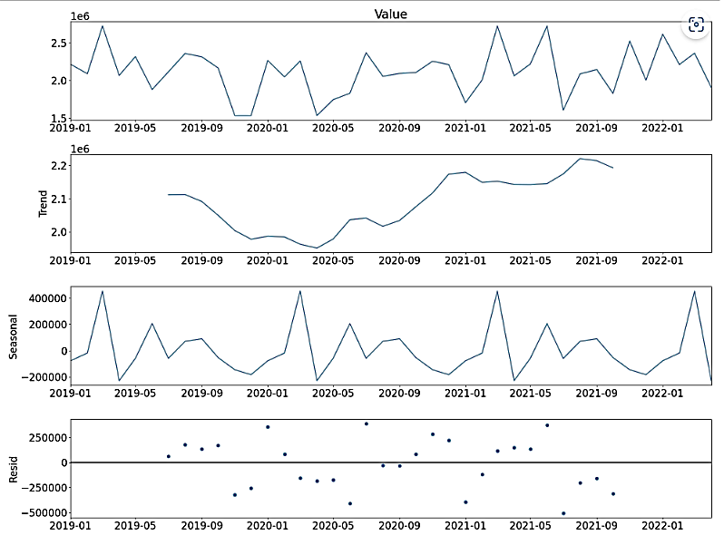
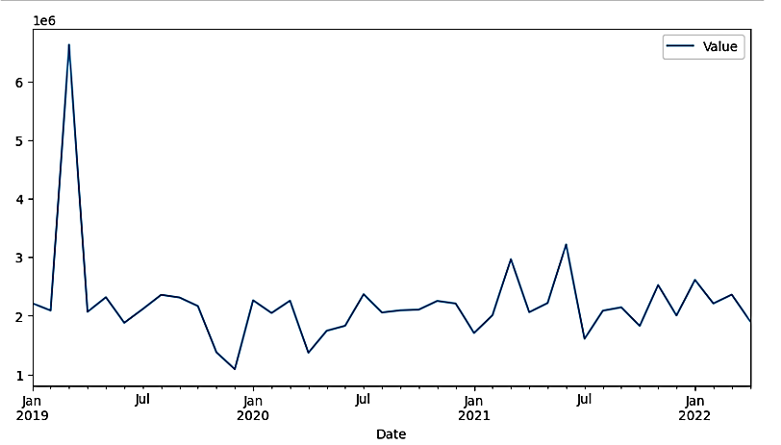
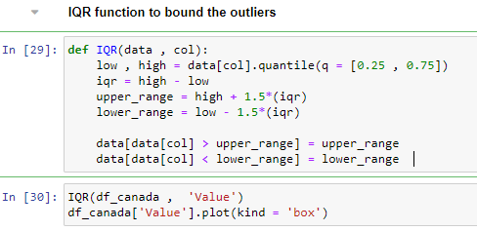
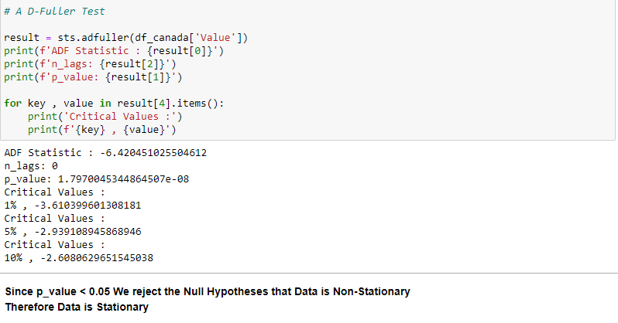
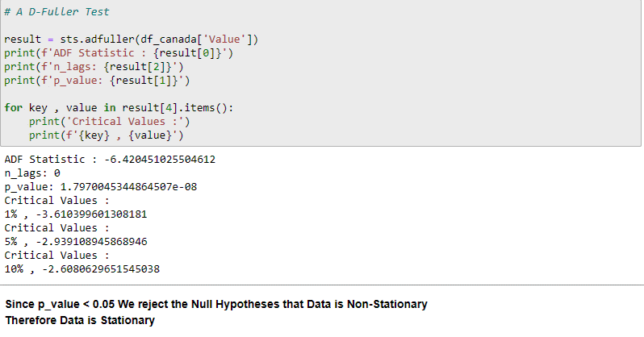
Solution – Canada

Slide 4
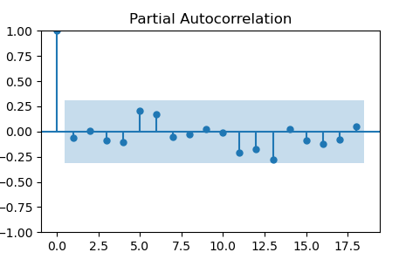
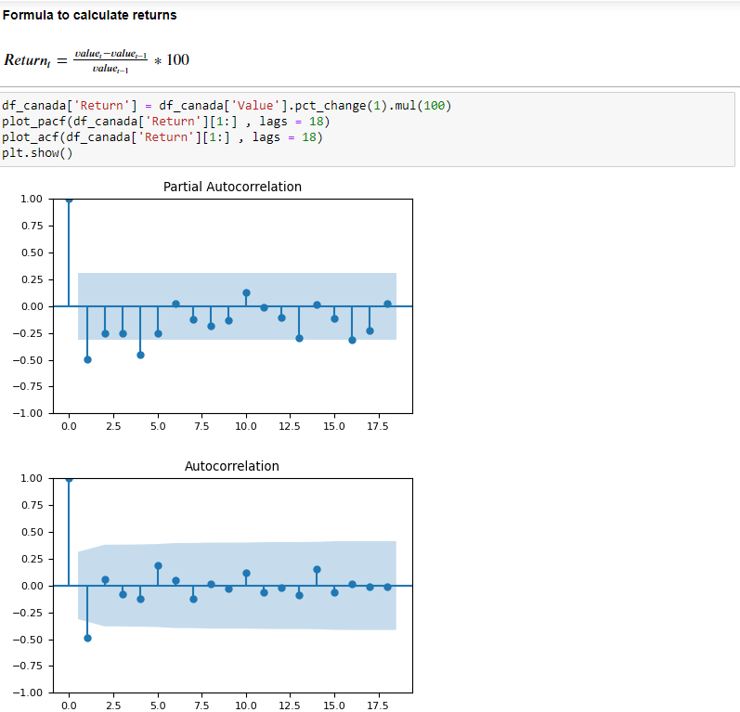
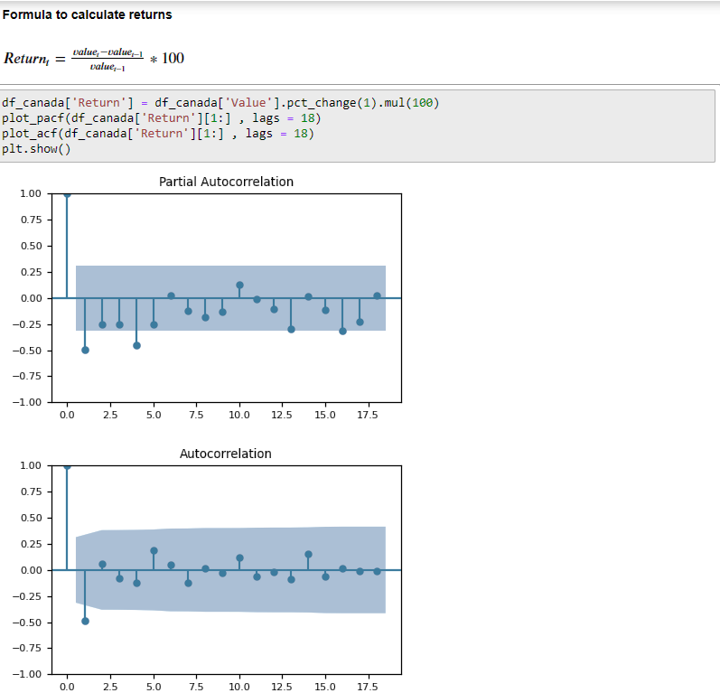
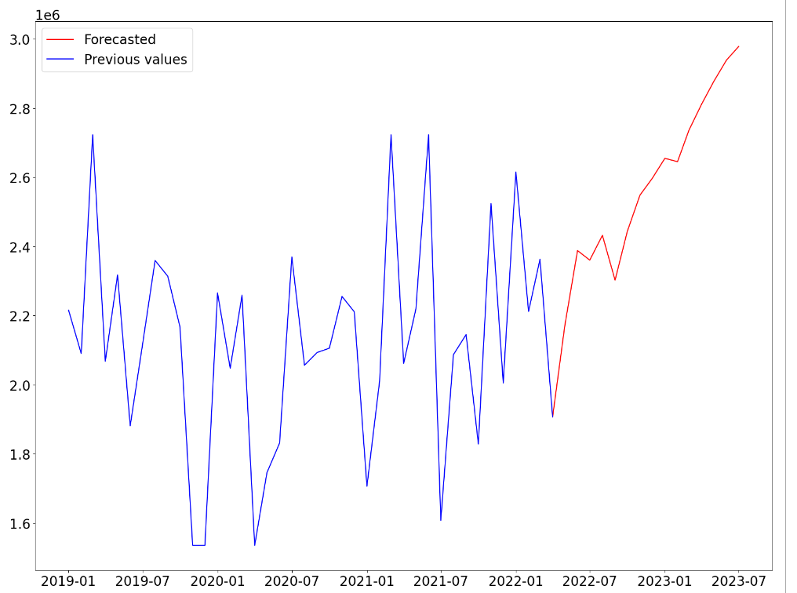

Slide 5
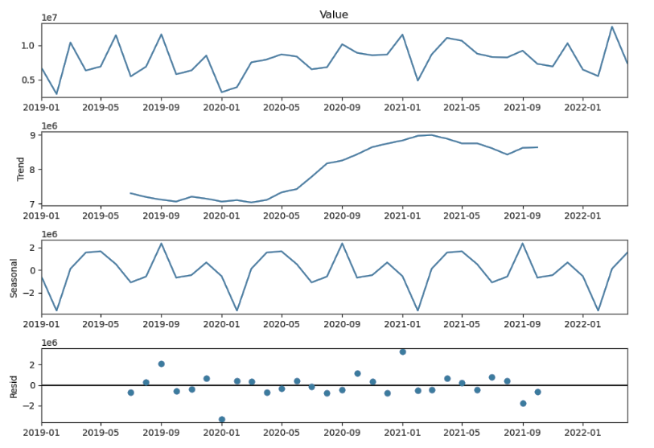
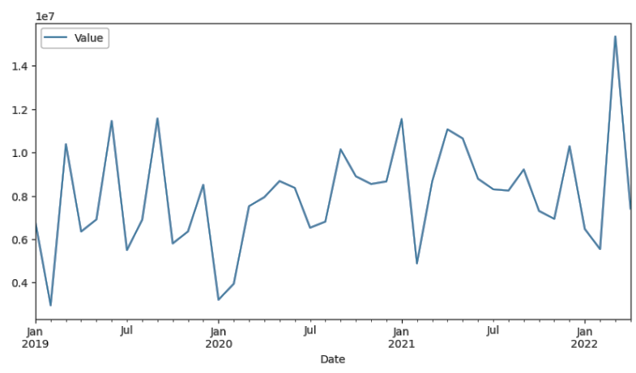
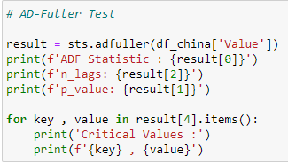
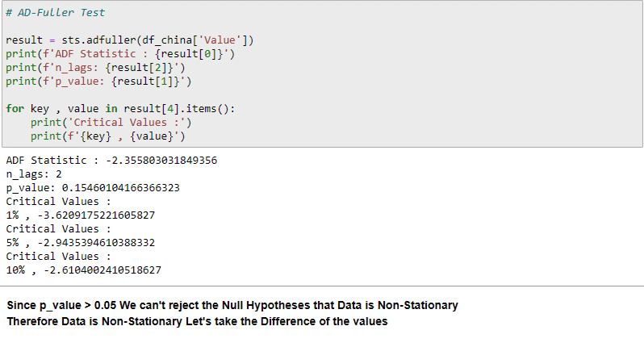
Solution – China

Slide 6
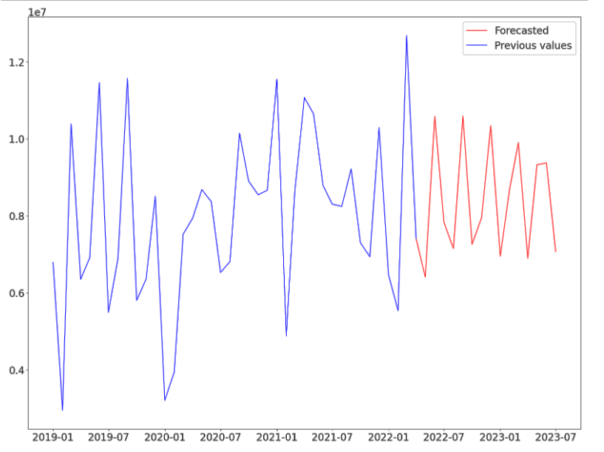
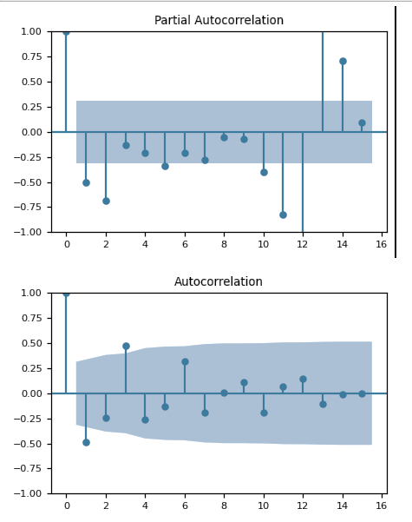

Slide 7
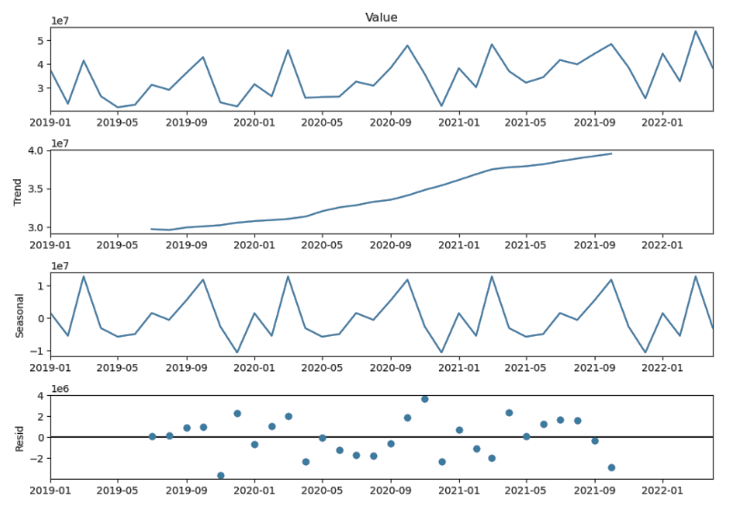
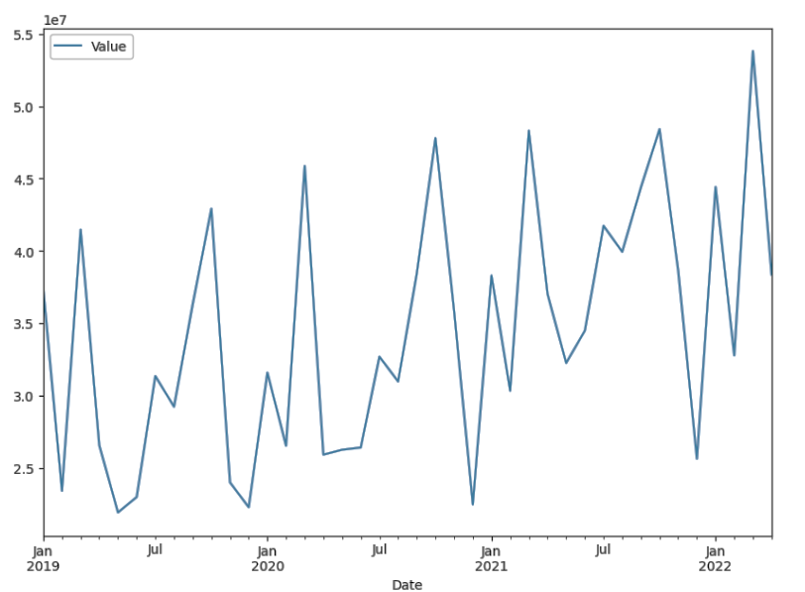
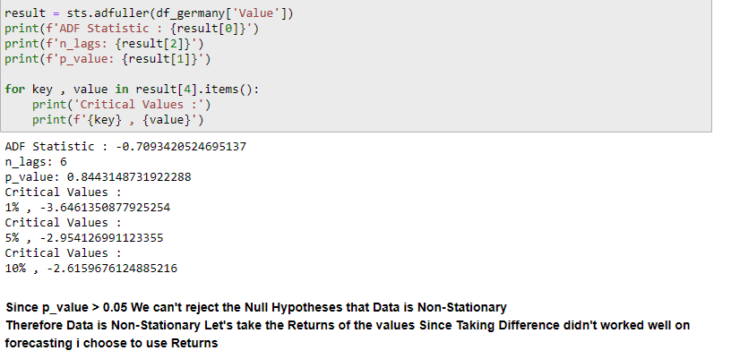
Solution – Germany

Slide 8
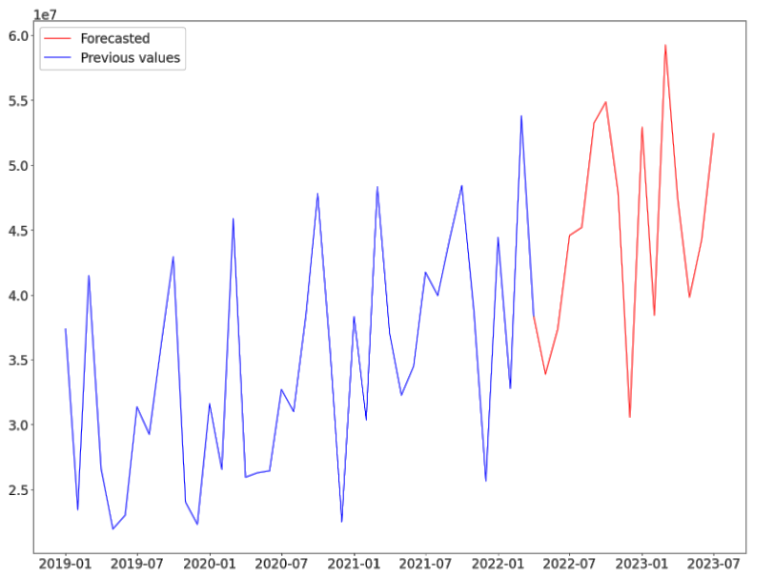
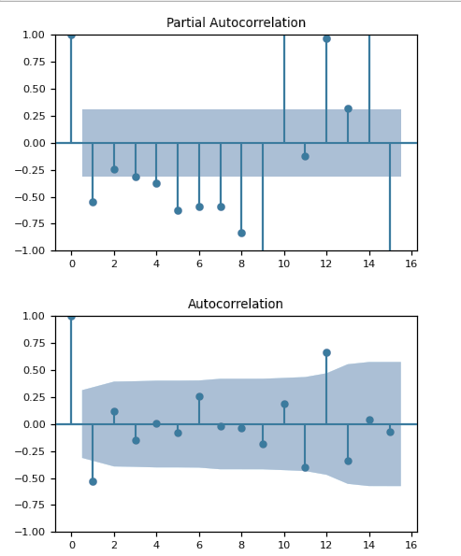

Slide 9
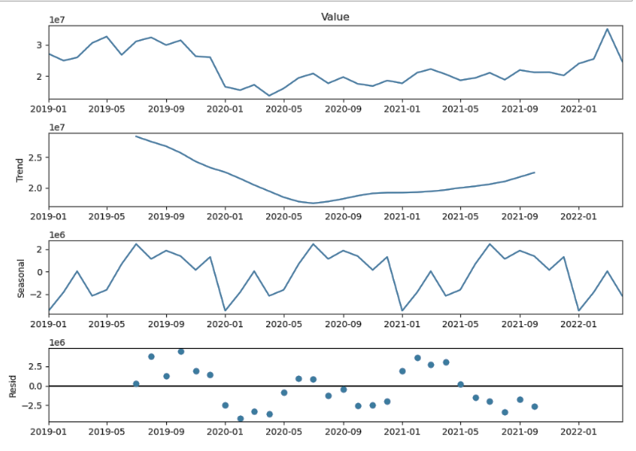
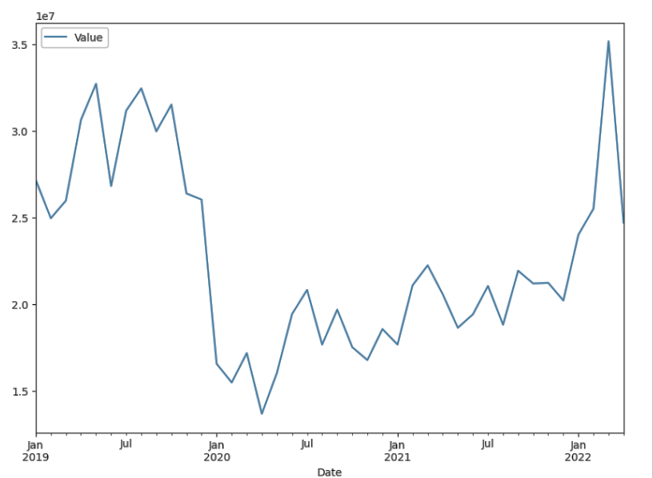
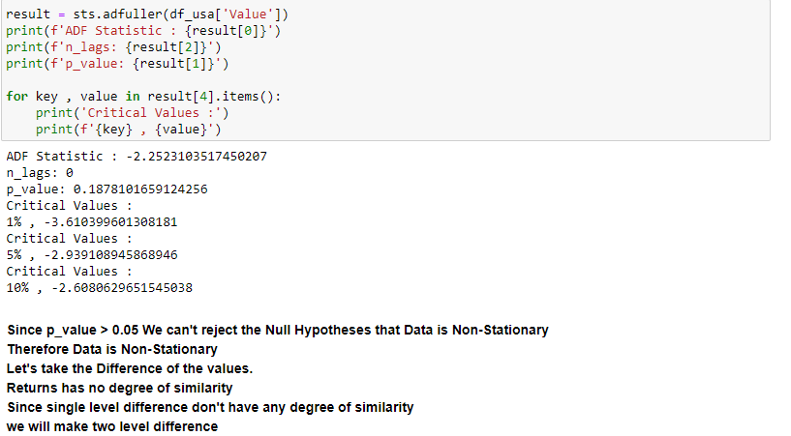
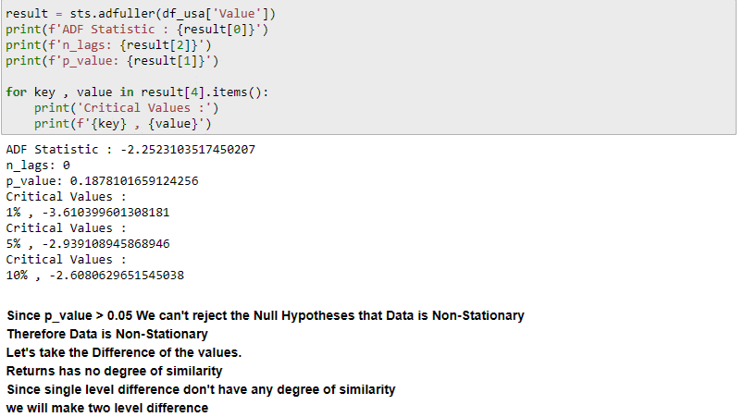
Solution – USA

Slide 10
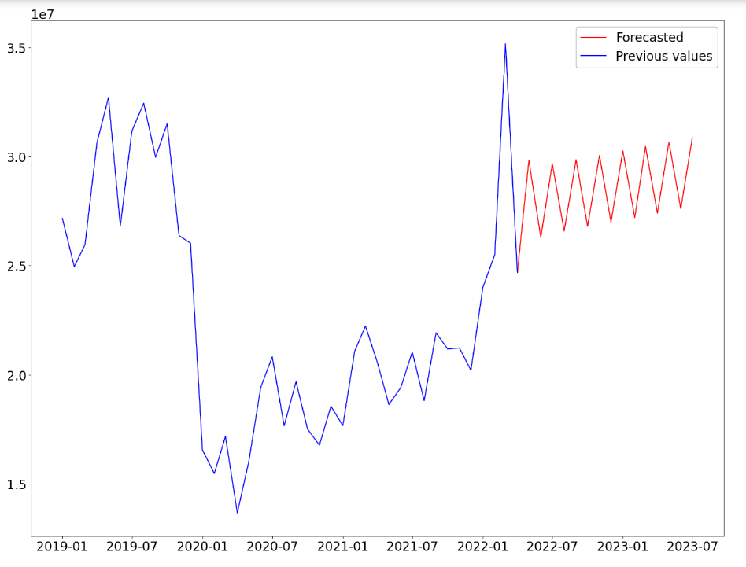
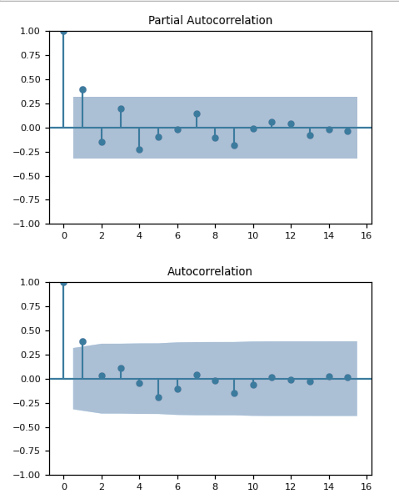

Slide 11
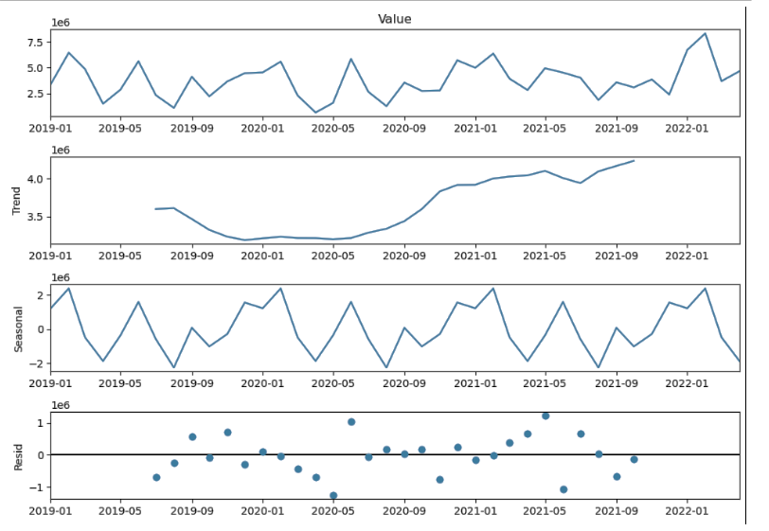
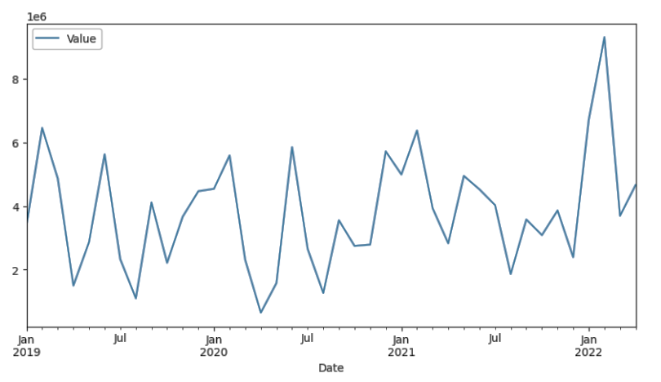
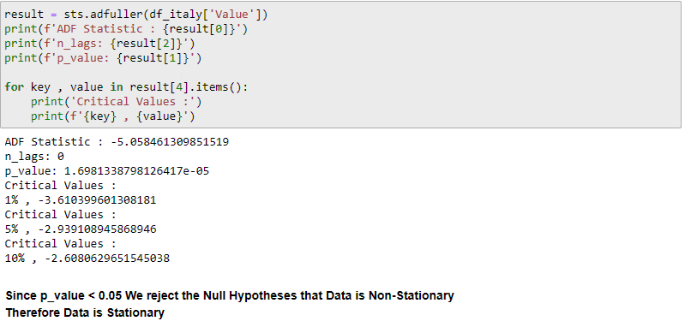
Solution – Italy

Slide 12
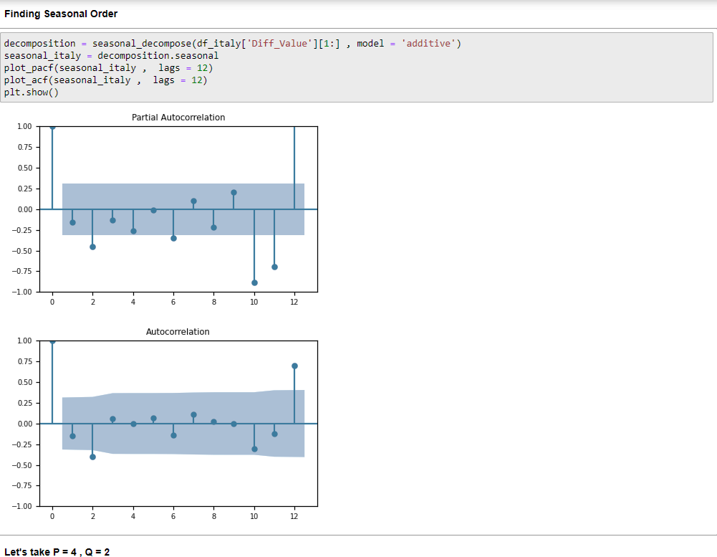
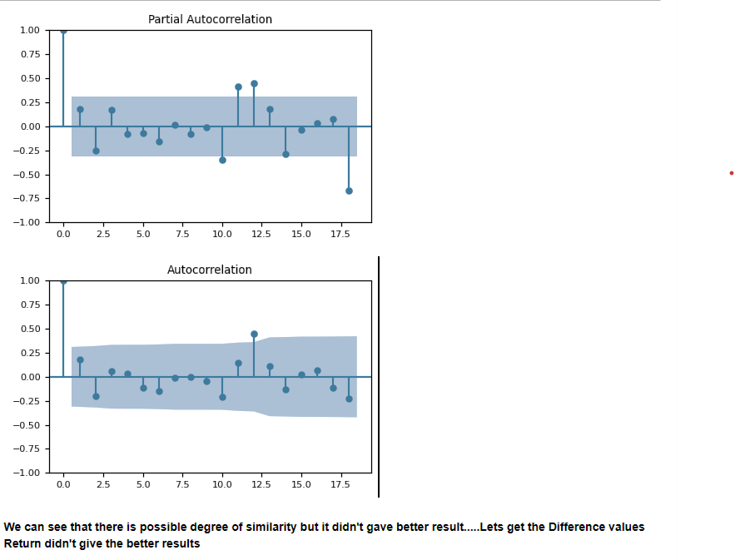
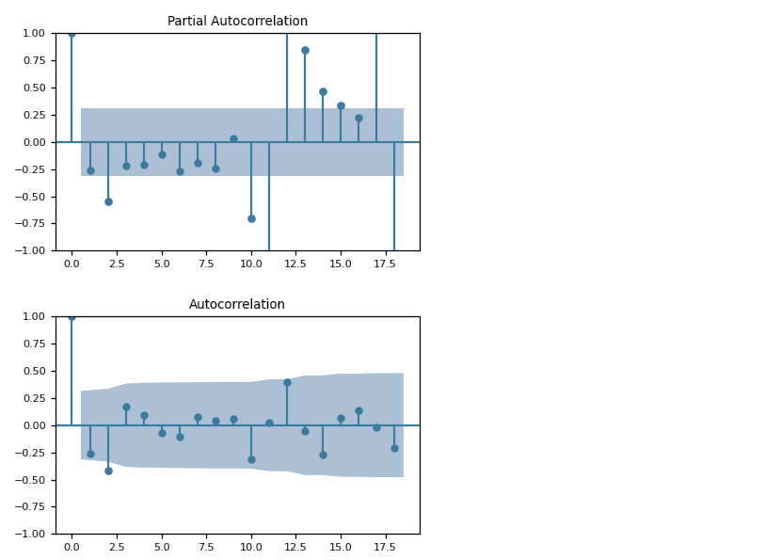
Original Values
Return Values
We can see that there are possible degrees of similarity, but it didn’t give better results
Let’s get the Difference which gives us better results.

Slide 13
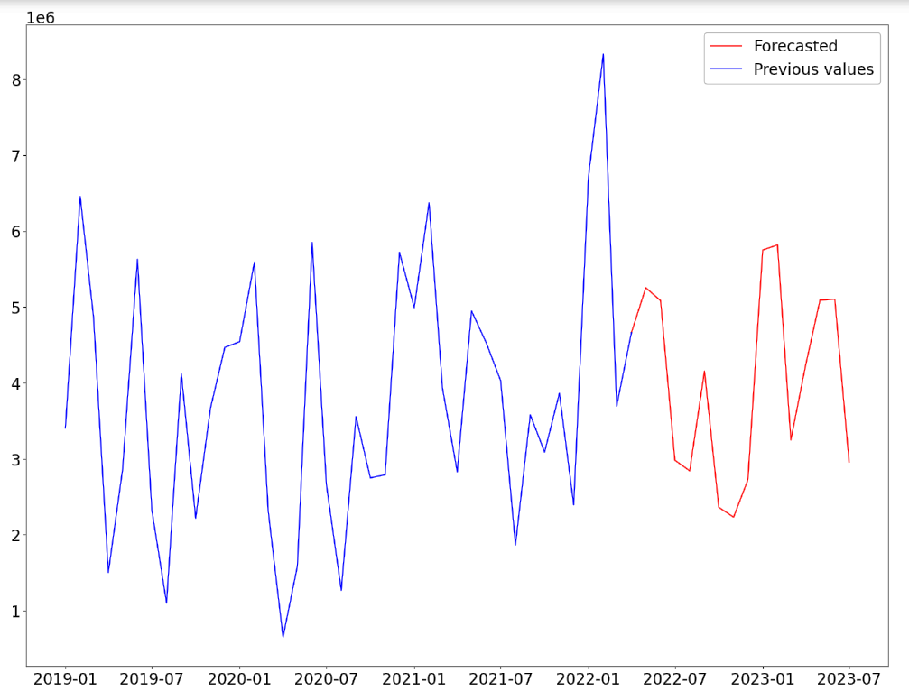

Slide 14
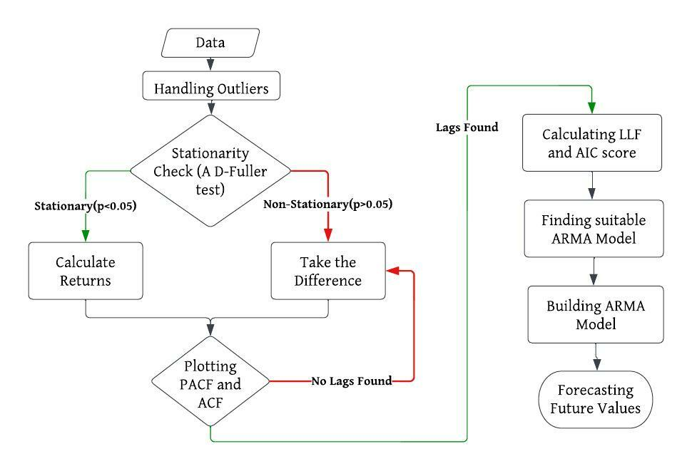
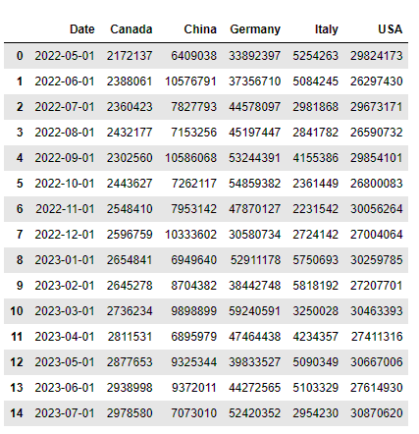
Methodology
Forecasted Values

Slide 15

What actually is happening inside the “ML Model”?
ASSUMPTIONS :
Data should be stationary – It means that the properties of the series doesn’t depend on the time when it is captured.
Data should be univariate – ARMA works on a single variable. Auto-regression is all about regression with the past values.
TEST DONE :
AUGMENTED DICKEY-FULLER TEST (ADF TEST) :
ADF Test is a common statistical test used to test whether a given Time series is stationary or not.
Null Hypothesis (H0): α=1
Alternate Hypothesis (H1): α<1
WORKING PRINCIPLE :
Autoregressive moving average (ARMA) forecasts apply advanced modeling techniques to forecast time-series data by first back fitting to historical data and then forecasting the future.
It comes from merging two simpler models - the Autoregressive, or AR, and the Moving Average, or MA.
Example : The equation for an ARMA (2,3) would look like this:

Slide 16
Future Challenges And Accuracy
CHALLENGES:
Forecasting for longer periods may not be efficient as it shows some repetitive patterns.
Model has to be retrained as we obtain more data over the period with different AR, MA order parameters.
ACCURACY AND IMPROVISATION:
By this methodology I got an average rmsle value of 0.2 to 0.3. This error may increase as we forecast over the period.
Accuracy can be improvised by:
Having some more data.
Having some exogenous features which helps in explaining the data.
Trying some other statistical transformations.

